Slide 1
CSE 430: Software Testing and Quality Assurance

Slide 2
Lecture 08

Slide 3
Dynamic Testing
Black-Box Testing Techniques

Slide 4
Decision Table-based Testing
Boundary value analysis and equivalence class partitioning methods do not consider combinations of input conditions.
Decision Table-based Testing consider each input separately.
There may be some critical behavior to be tested when some combinations of input conditions are considered.

Slide 5
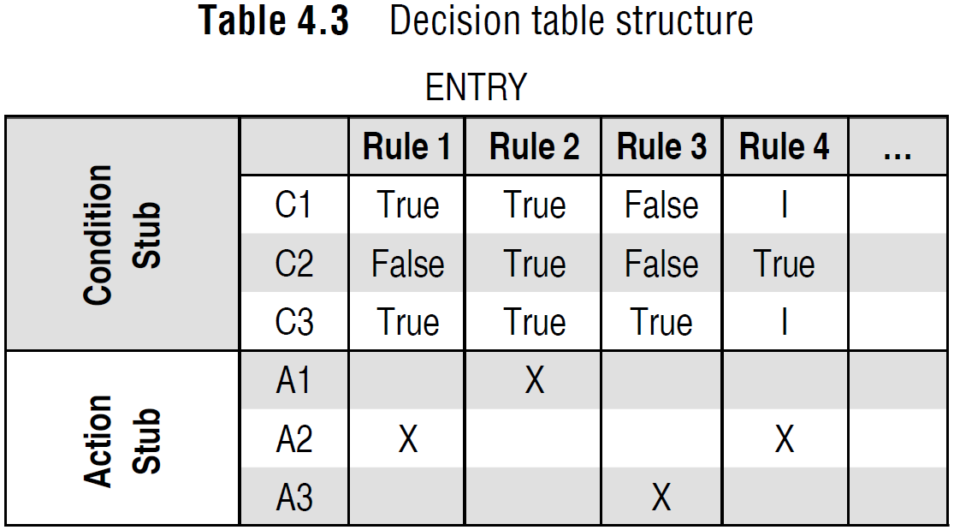
Formation of Decision Table

Slide 6
Formation of Decision Table
Condition stub: It is a list of input conditions for which the complex combination is made.
Action stub: It is a list of resulting actions which will be performed if a combination of input condition is satisfied.
Condition entry: It is a specific entry corresponding to input conditions mentioned in the condition stub.
Action entry: It is the entry in the table for the resulting action to be performed when one rule (which is a combination of input condition) is satisfied.

Slide 7
Guidelines for Decision Table
List all actions that can be associated with a specific procedure (or module).
List all conditions (or decision made) during execution of the procedure.
Associate specific sets of conditions with specific actions, eliminating impossible combinations of conditions.
Define rules by indicating what action occurs for a set of conditions.

Slide 8
Test Case Design Using Decision Table
Interpret condition stubs as the inputs for the test case.
Interpret action stubs as the expected output for the test case.
Rule, which is the combination of input conditions, becomes the test case itself.
If there are k rules over n binary conditions, there are at least k test cases and at the most 2^{n} test cases.

Slide 9
Example 4.8
A program calculates the total salary of an employee with the conditions that if the working hours are less than or equal to 48, then give normal salary. The hours over 48 on normal working days are calculated at the rate of 1.25 of the salary. However, on holidays or Sundays, the hours are calculated at the rate of 2.00 times of the salary. Design test cases using decision table testing.

Slide 10
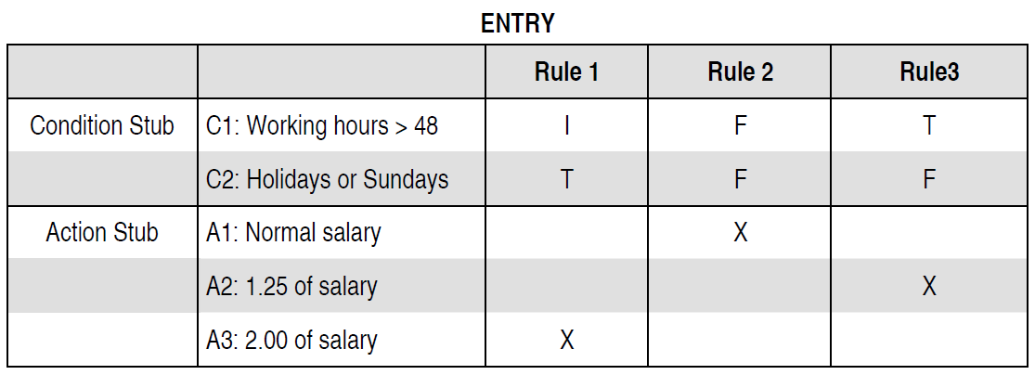
Solution

Slide 11
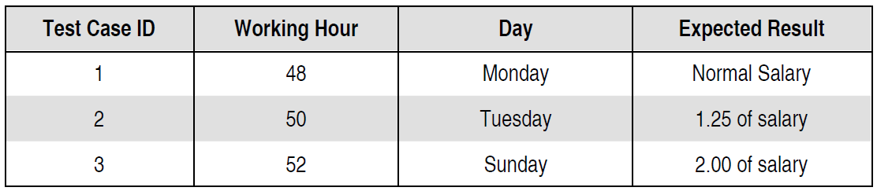
Solution

Slide 12
Example 4.9
A wholesaler has three commodities to sell and has three types of customers. Discount is given as per the following procedure:
For DGS & D orders, 10% discount is given irrespective of the value of the order.
For orders of more than Rs 50,000, agents get a discount of 15% and the retailer gets a discount of 10%.
For orders of Rs 20,000 or more and up to Rs 50,000, agents get 12% and the retailer gets 8% discount.
For orders of less than Rs 20,000, agents get 8% and the retailer gets 5% discount.
The above rules do not apply to the furniture items wherein a flat rate of
10% discount is admissible to all customers irrespective of the value of the order. Design test cases for this system using decision table testing.

Slide 13
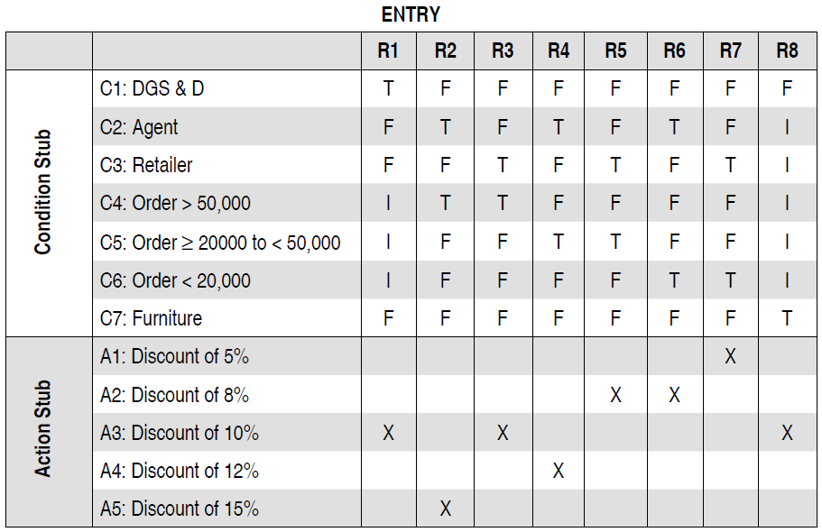
Solution

Slide 14
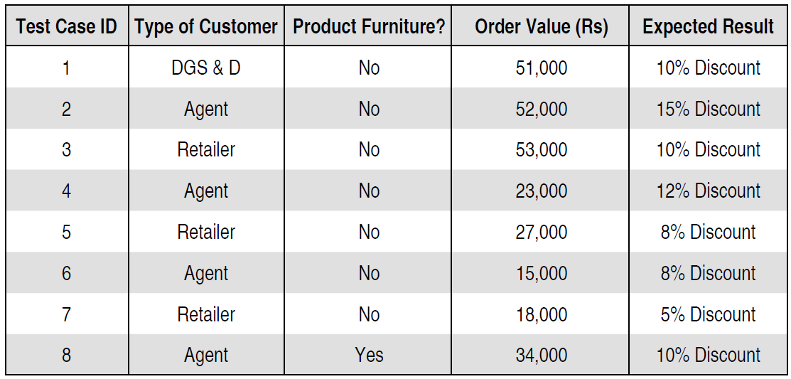
Solution

